Slide 1

Virtual Router
https://virtualrouter.codeplex.com/
By :
Tamar Bash
Maor Taieb

Slide 2
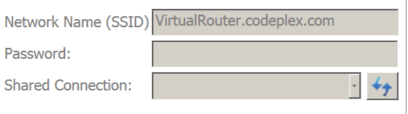
What is Virtual Router?
Virtual Router is a free, open source software based router for PCs running Windows 8, Windows 7 or Windows Server 2008 R2.
Using Virtual Router, users can wirelessly share any internet connection (Wifi, LAN, Cable Modem, Dial-up, Cellular, etc.) with any Wifi device (Laptop, Smart Phone, iPod Touch, iPhone, Android Phone, Zune, Netbook, wireless printer, etc.)
These devices connect to Virtual Router just like any other access point, and the connection is completely secured using WPA2 (the most secure wireless encryption.)

Slide 3

Where can Virtual Router be used?
Home
Office
School
Airport
Bus Station
The Park
Grandmas House
The In-Laws
Absolutely Anywhere

Slide 4

Why to use IT….
Unlike similar applications, Virtual Router is not only completely Free, but will not annoy you with any advertisements.
Also, since Virtual Router is not ad-supported, it does not track your web traffic the way other ad-supported applications do/can.
No Advertising, No Hassle.

Slide 5

How it works ?
The Wireless Network create/shared with Virtual Router uses WPA2 Encryption, and there is not way to turn off that encryption. This is actually a feature of the Wireless Hosted Network API's built into Windows 7 and 2008 R2 to ensure the best security possible.
You can give your "virtual" wireless network any name you want, and also set the password to anything. Just make sure the password is at least 8 characters.
BTW, this project is written entirely in C#.

Slide 6
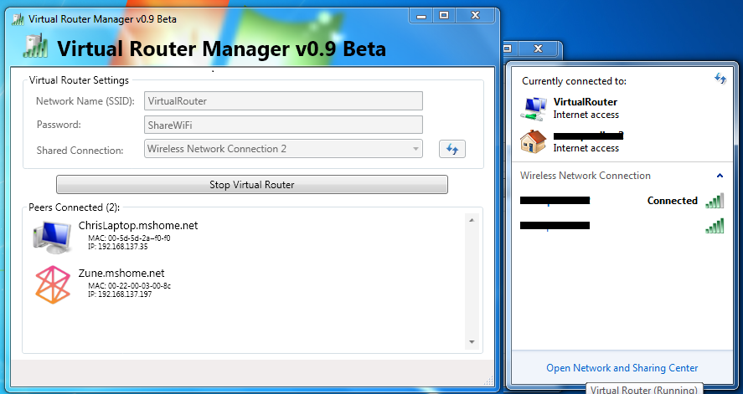
Demo

Slide 7

Documents
Frequently Asked Questions:
Will I incur extra charges from my ISP using Virtual Router?
Which Wifi Devices are Supported?
Virtual Router will not start after installation.
How do I know if my computer/hardware supports Virtual Router?
Can I use Virtual Router with Windows Vista or Windows XP?
Is the connection encrypted? How secure it this?
How To Change Device (Connected Peer) Icon.

Slide 8
UML
Under construction….

Slide 9
Bugs & Tips
Error: "group or resource is not in the correct state to perform the requested operation"
Here's a Hotfix available from Microsoft for a common cause of this problem on Windows 7 and Windows Server 2008 R2: http://support.microsoft.com/kb/2496820 If the hotfix doesn't work, or you aren't using Windows 7 or 2008 R2, then you could try some of the suggestions at the following link: http://superuser.com/questions/373861/how-can-i-start-hostednetwork-on-windows-7
Support a large list of devices.
Money save .
High Secured Level.

Slide 10

Questions …

